Slide 1
Embedded Speech to Text William Pickering

Slide 2
Order of Execution
Understand the Goal and Scope of the Project
Understand Requirements
Frequency range of source
Time allowed to collect and process data
Determine how to Implement
The format of the data to collect
How to collect the data and the rate
How to process the data
How to compare the data
How to output the results
Implement, Test, and Revise

Slide 3
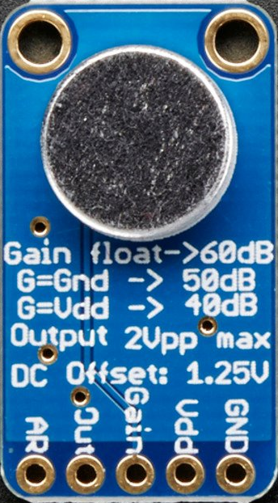
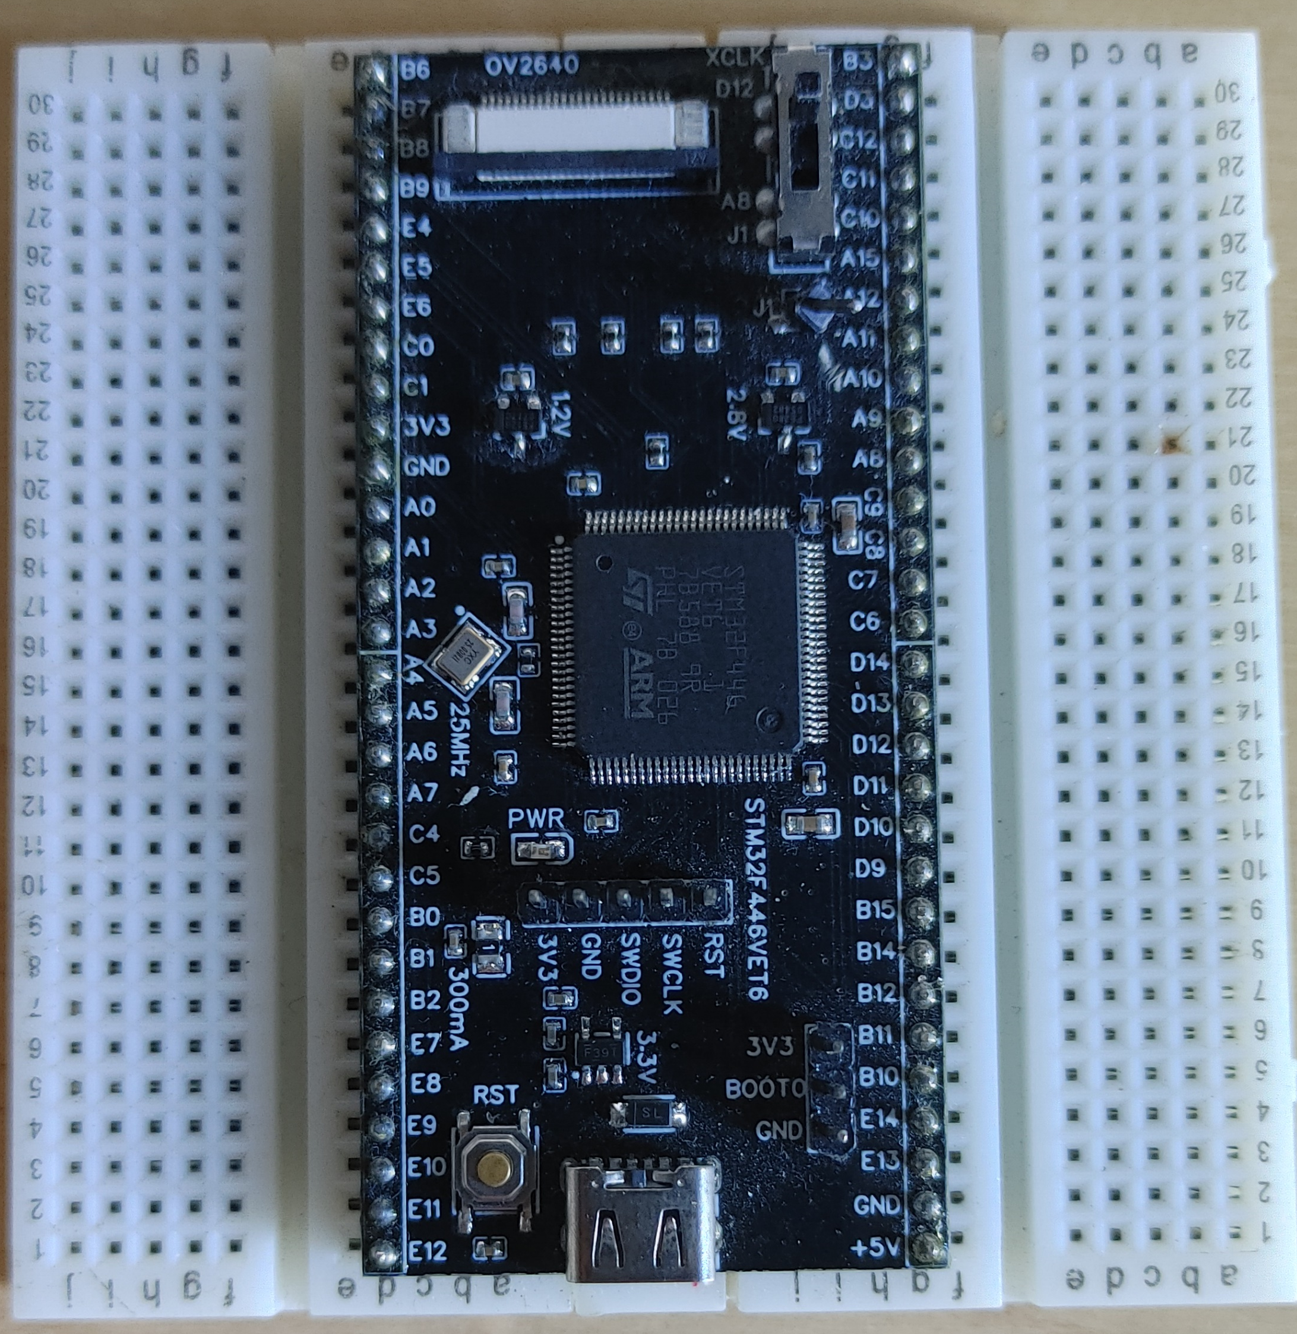


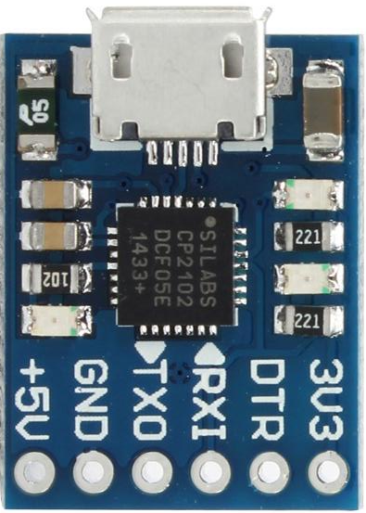
Project Description
Goal of the Project
Build experience
Sampling data at specific intervals
Using Fast Fourier transform (FFT) algorithms
Using direct memory access (DMA)
A particle device to use in future projects
The device would
Receive input from a human voice
Convert phonic sounds to a string of characters
Use a spell checker algorithm to convert the string of characters to a list of valid words
Output the words as if being typed form a keyboard
MAX9814
(Microphone Amplifier)
CP2102
(TTL UART to USB)
PC
STM32F446VET6

Slide 4
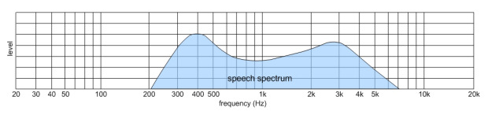
Requirements
Analyze the human voice.
Between 0.2 kHz – 6 kHz
Used: https://www.compadre.org/osp/pwa/soundanalyzer/ to confirm
Finish processing the current phonic before the next one starts
Around 83ms
https://av-info.eu/index.html?https&&&av-info.eu/audio/speech-level.html
0ms
31.25ms
83ms
Amount of time a phonic is pronounced for
Capture Data | Process data

Slide 5
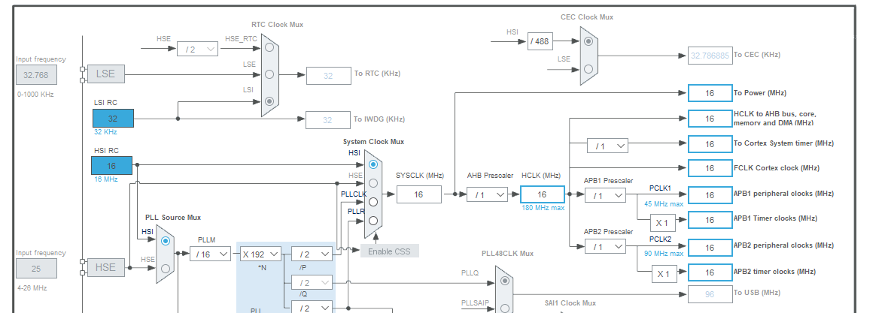

How to Sample at a Desired Rate
Implementation Options
Needed to sample 2x the frequency of the human voice (0.2 kHz – 6 kHz)
Set up a timer interrupt
Set up DMA and adjust the analog digital convertor (ADC) clock
$(f_{clk}/prescaler)/i_{count}=f_{sample}$

Slide 6
Processing the Data - First Iteration
Setting up DMA in a Ping-Pong style
An interrupt is called, when the buffer is half-full and can be processed while the other half is being filled.
Data needs to be processed before being overwritten
Complex FFT Library: https://www.kurims.kyoto-u.ac.jp/~ooura/fft.html
Pros:
Simple to integrate
Able to run on a desktop environment
Open Licensing
Comparable speeds to KissFFT and better than FFTW
Cons:
Every other output in the array was imaginary, required post-processing
Size of the array must be 2^n
Array size value over 2,048 would take too long to process

Slide 7
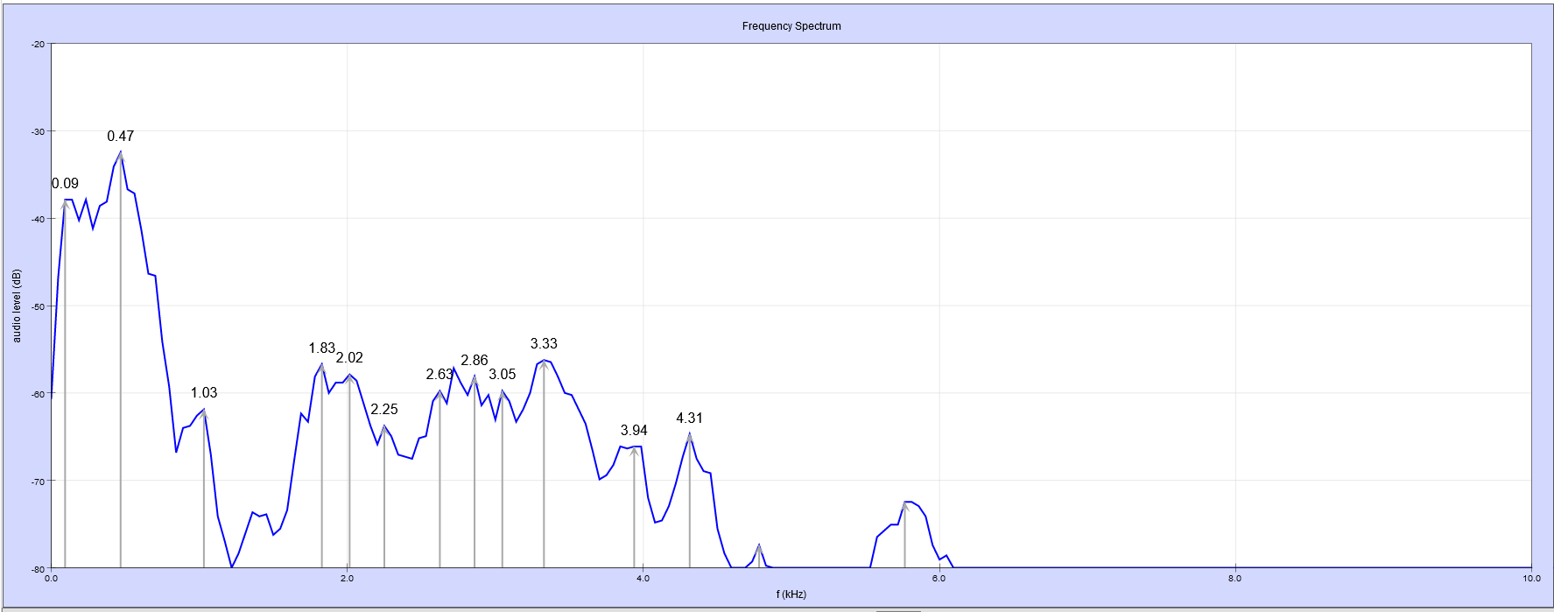
Comparing the Data - First Iteration
Created a HashMap
Key: 64-bit unsigned int
Value: char array
Each bit of the key represented a range of frequencies
[0]: 0 – 94hz
[1]: 95 – 189hz
…
[63] 5985 – 6079hz
Set the bit if there is a maximum in the corresponding range.
/ĕ/ [10101000…]

Slide 8
Revisions
Sampling at too high of a frequency (12 kHz)
Resulted in too large of a step size (~200 Hz) of the FFT output
Solved by decreasing the sampling rate
ADC outputs 12-bits while UART transmitting takes 8-bit
Solved by bit shifting into a 16-bit unsigned int

Slide 9
Future Work
Implement finding maximums
Implement the phonics HashMap onto an SD card
Use a real FFT algorithm rather than a complex FFT
Test out the performance of the CMSIS Real FFT library
Test recording all data to a buffer then performing the FFT

